Slide 1



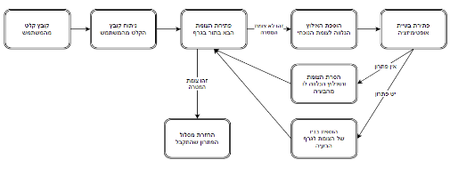
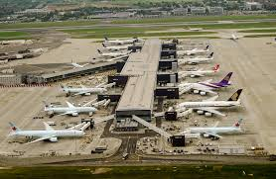
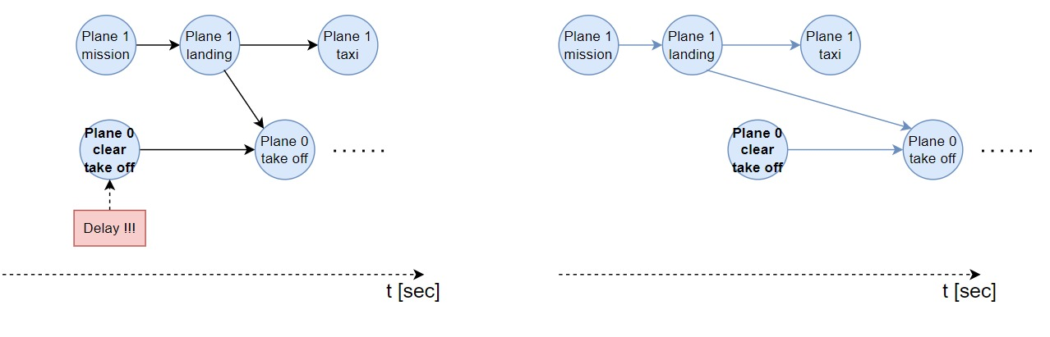
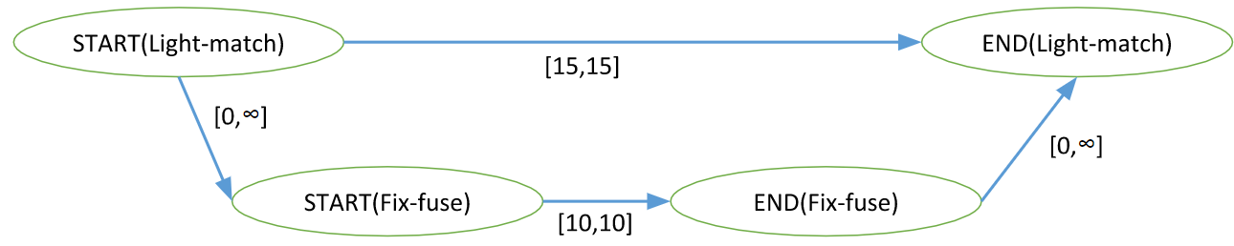
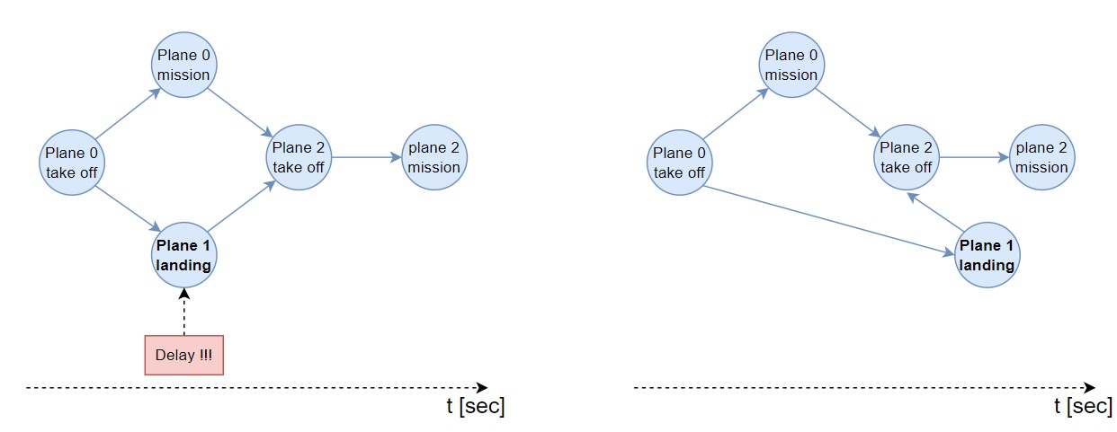
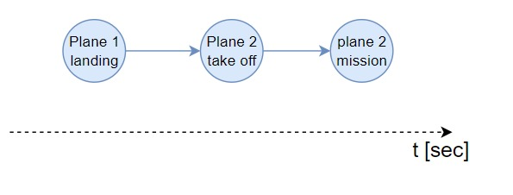
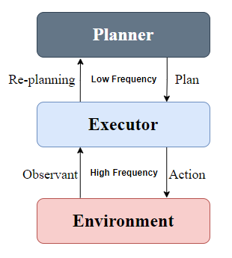
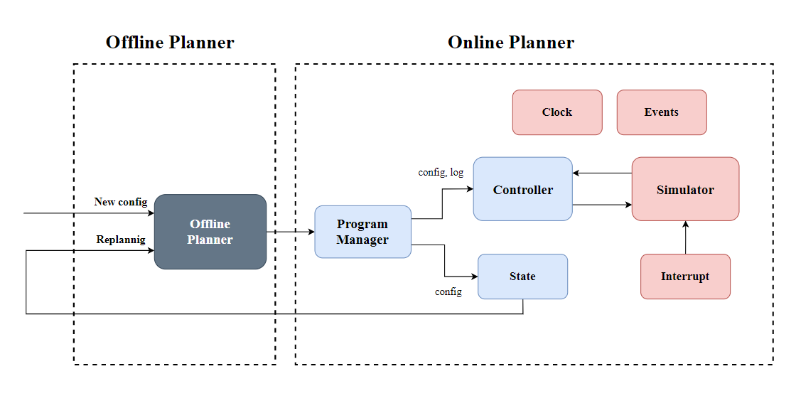
Online Algorithm for Takeoff and Landing Management
Yoav Cohen and Hodaya Cohen-Adiv, Supervised by Ayal Taitler
Introduction
Planner
Real-Time Interrupts
An airport has a lot of operations everyday.
Multiple planes that are simultaneously take off and land.
Operations that depend on other operations.
Unexpected problems create conflicts and may change the day plan.
Airport management is done with a day plan which is executed in REAL TIME.
The interrupts module create random disorders which delay actions in real-time. This module is part of the Environment block.
For a given day plan, the algorithm can resolve the delay in one of two ways:
Stretching the STN graph
Replanning of the problem
Planner – Block Diagram
The Offline Planner input is a config file, and the output is a STN graph.
Stretching the STN graph
STN graph
The planning problem under time constrains is an optimization problem that finds the optimal solution.
The constrains are represented in data structure called STN graph.
This solution is when the program can proceed with the delay that has occurred. The delay causes a time shifting for all the graph, but the problem is still feasible.
Airport
Project Goal
Creating an online algorithm for managing takeoffs and landings
Our algorithm ran the offline plan while dealing with real-time malfunctions and changes.
The algorithm must decide whether the program can run with the different constraints or whether re-planning is needed.
An action can’t be executed if not all her ancestors are finished.
Replanning of the plan
Our Algorithm
The Executor dispatches actions to the Environment.
For each action we verify:
All ancestors are done.
The next sate of the environment is feasible.
The action is ready.
If one of the verifications failed the algorithm will start replanning the problem.
Challenges
This solution is when the program can’t proceed with the delay that has occurred. The problem isn’t feasible, and we need to plan a new STN graph with the new delay. The replanning is being carried out in relation to the current state of the world.
Planning with times and constraints in real time.
Feedback from the online algorithm to the offline algorithm.
General Schema
Block Diagram
Future Work
Add more types of interrupts to simulate a more realistic world in a simulation.
Add a GUI - make the system inactive to the user with which he will be able to track the planes and lanes in real-time.
The Planner is the Offline Algorithm.
The Executor is the Online Algorithm.
The Environment is the testing module that simulates an airport with interrupts in real-time.
The blue blocks constitute the Executor.
The red blocks constitute the Environment.

